Slide 1
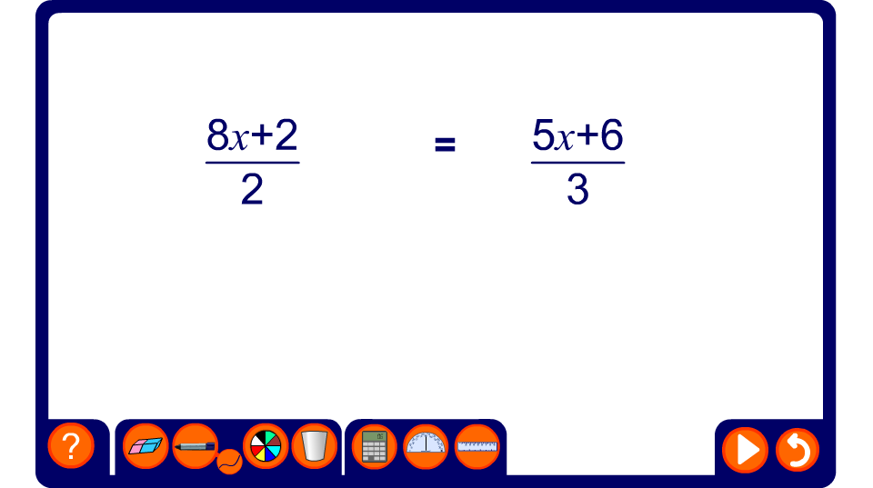


Simplifying equations by cross-multiplication

